Slide 1

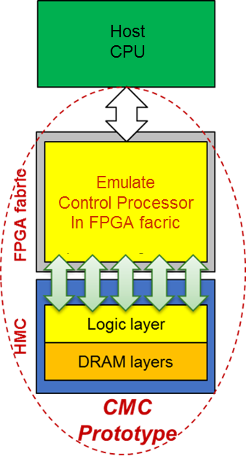
P3: Custom Memory Cube (CMC)
F3
Goal
Create flexible research platform for design space exploration of CMC apps & arch before existence of CMC
Motivation
Memory-intensive Big Data apps: memory bottleneck & high energy consumption
HMC: higher B/W & lower power than conventional memories
Potential for C-RAM* & PIM** processing (CMC)
Approach
Explore performance measurement methods for CMC platform
Research performance modelling for notional CMC architecture
Initial case study CMC app: DRE*** of LLNL
*C-RAM: Computational RAM
**PIM: Processor In Memory
⁺DRE: Data Reordering/Rearrangement Engine
From LLNL (Lawrence Livermore National Lab)

Slide 2
Measurement Methods on CMC Platform
Merlin board*
**
M3 M4 M5
E’
Achievements
Initial prototype of CMC research platform:
FPGA + HMC: Implemented on Convey Merlin* board
Maximize observability: instrumented Merlin infrastructure Verilog code with hardware performance monitors
Currently available (C’, D’, M1, M2); will be available (M3, M4, M5); ;to be determined (E’)
*Merlin board from Convey Computer, Inc. (now part of Micron)
** VB: view buffer using in DRE

Slide 3
Case Study: Notional CMC Modeling (1)
F3
Merlin board
M3 M4 M5
E’
Model of
notional CMC*
* Nair, R., et al. "Active Memory Cube: A processing-in-memory architecture for exascale systems.“ IBM Journal of Research and Development 59.2/3 (2015): 17-1.

Slide 4
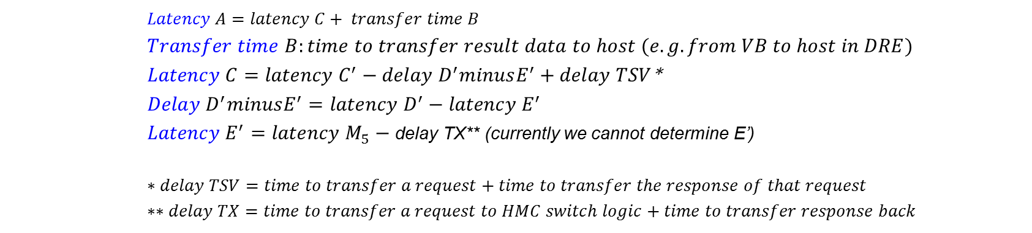


Case Study: Notional CMC Modeling (2)
F3
Model of notional CMC
CMC platform on Merlin board
**
$$TX$$
M3 M4 M5
E’
$$delay D^{′}minusE^{′}$$
$Latency A=latency C+ transfer time B$
$$Transfer time B:time to transfer result data to host (e.g. from VB to host in DRE)$$
$Latency C=latency C^{′}−delay D^{′}minusE^{′}+delay TSV$*
$$Delay D^{′}minusE^{′}=latency D^{′}−latency E^{′}$$
$Latency E^{′}=latency M_{5}−$ delay TX** (currently we cannot determine E’)
$$∗delay TSV=time to transfer a request+time to transfer the response of that request$$
$$∗∗delay TX=time to transfer a request to HMC switch logic+time to transfer response back$$
Latency: round-trip delay from input into a point in the system to desired outcome

Slide 5
P3: Custom Memory Cube (CMC)
F3
Perf. modelling of notional CMC architecture
Case study: Data Reordering/Rearrangement Engine
Achievements
Placeholder 1
Placeholder 2
Placeholder 3
Performance of single memory operations (wr/rd)
Performance of DRE operations
Performance of DRE applications: SpMV

